Slide 1
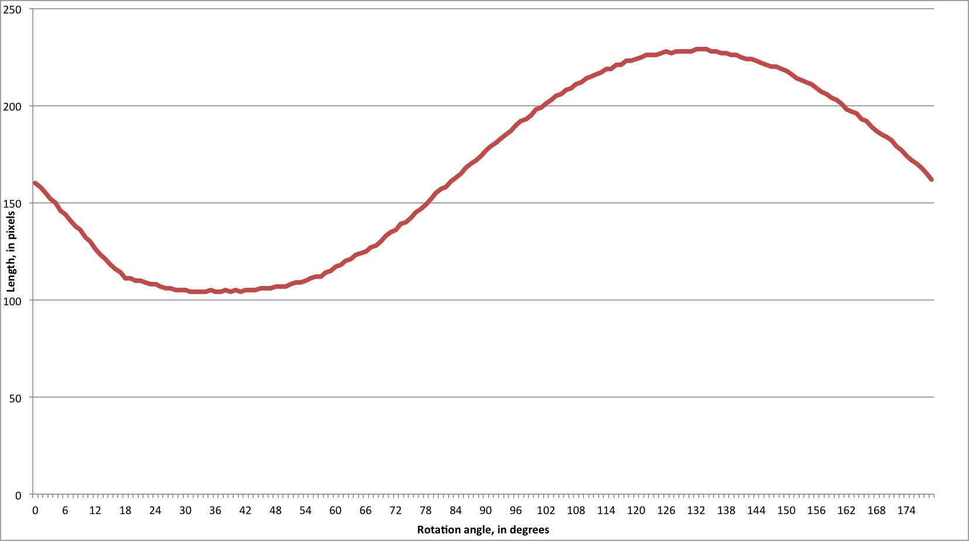

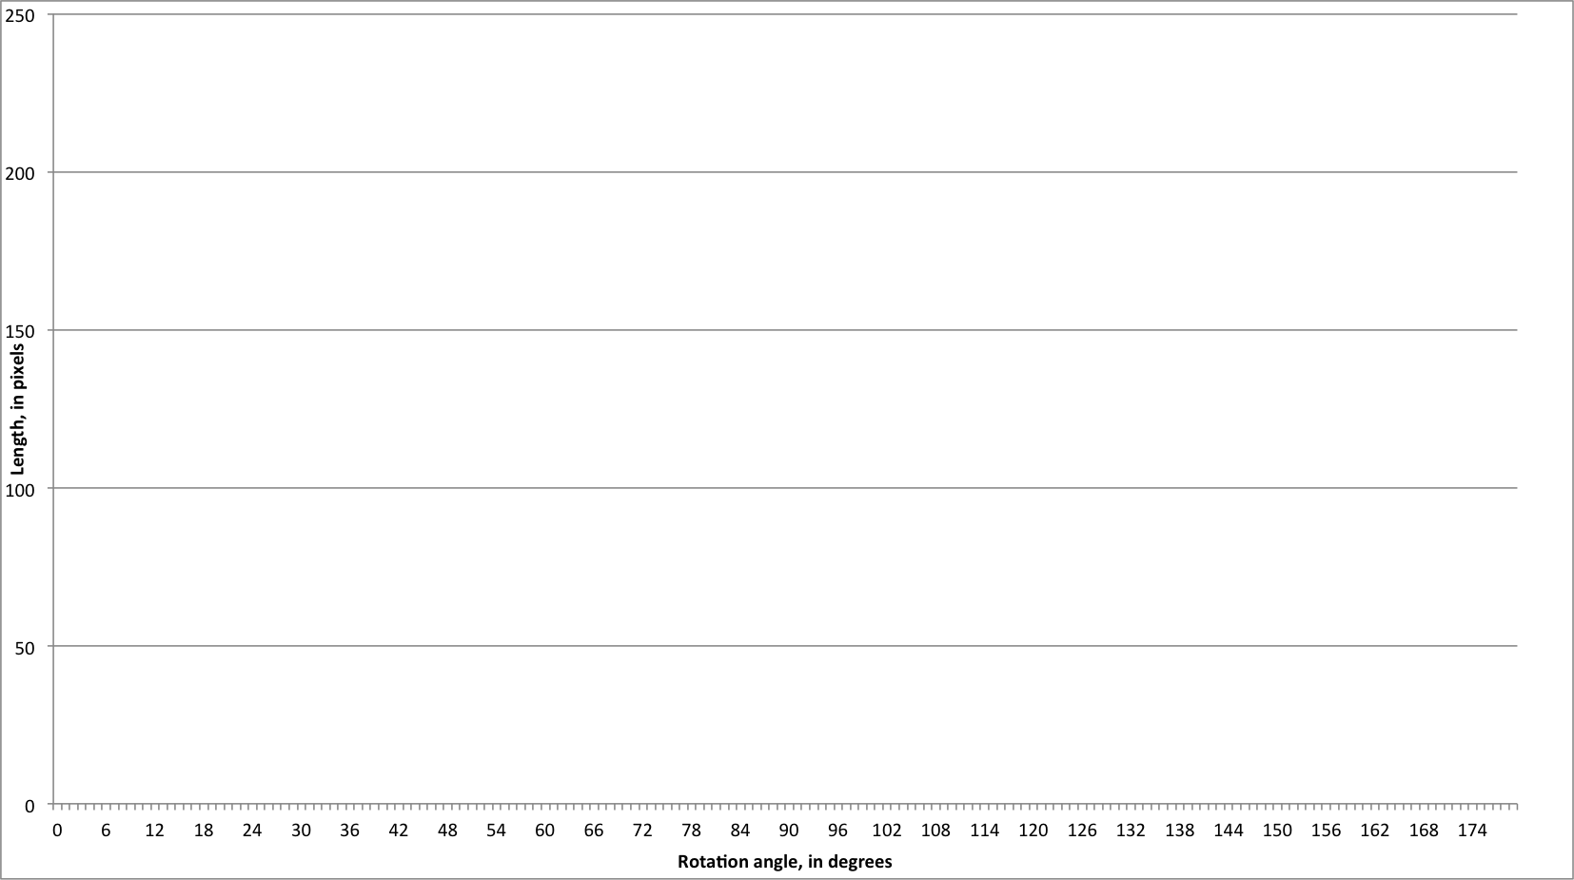
Measurement
Maximum length
Maximum width
Total area
Joseph Meltzer

